Slide 1
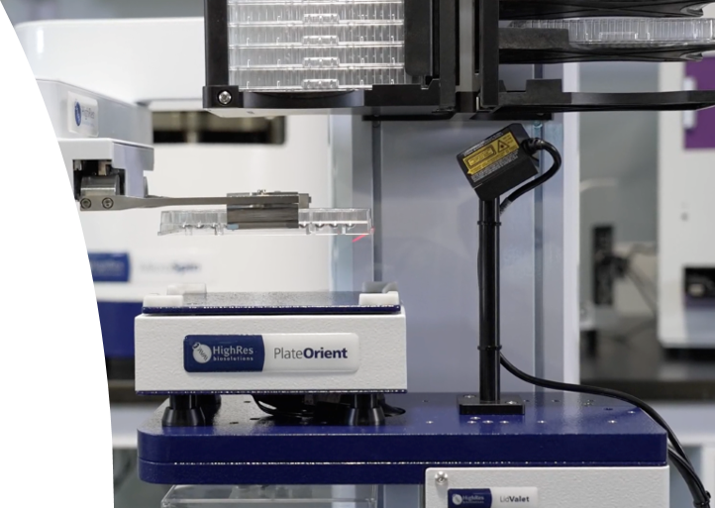
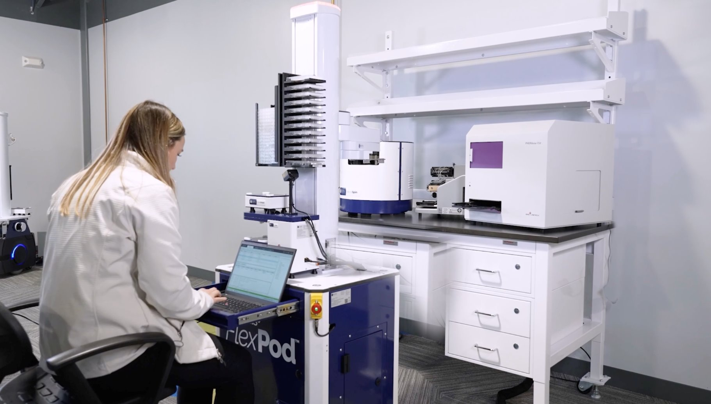
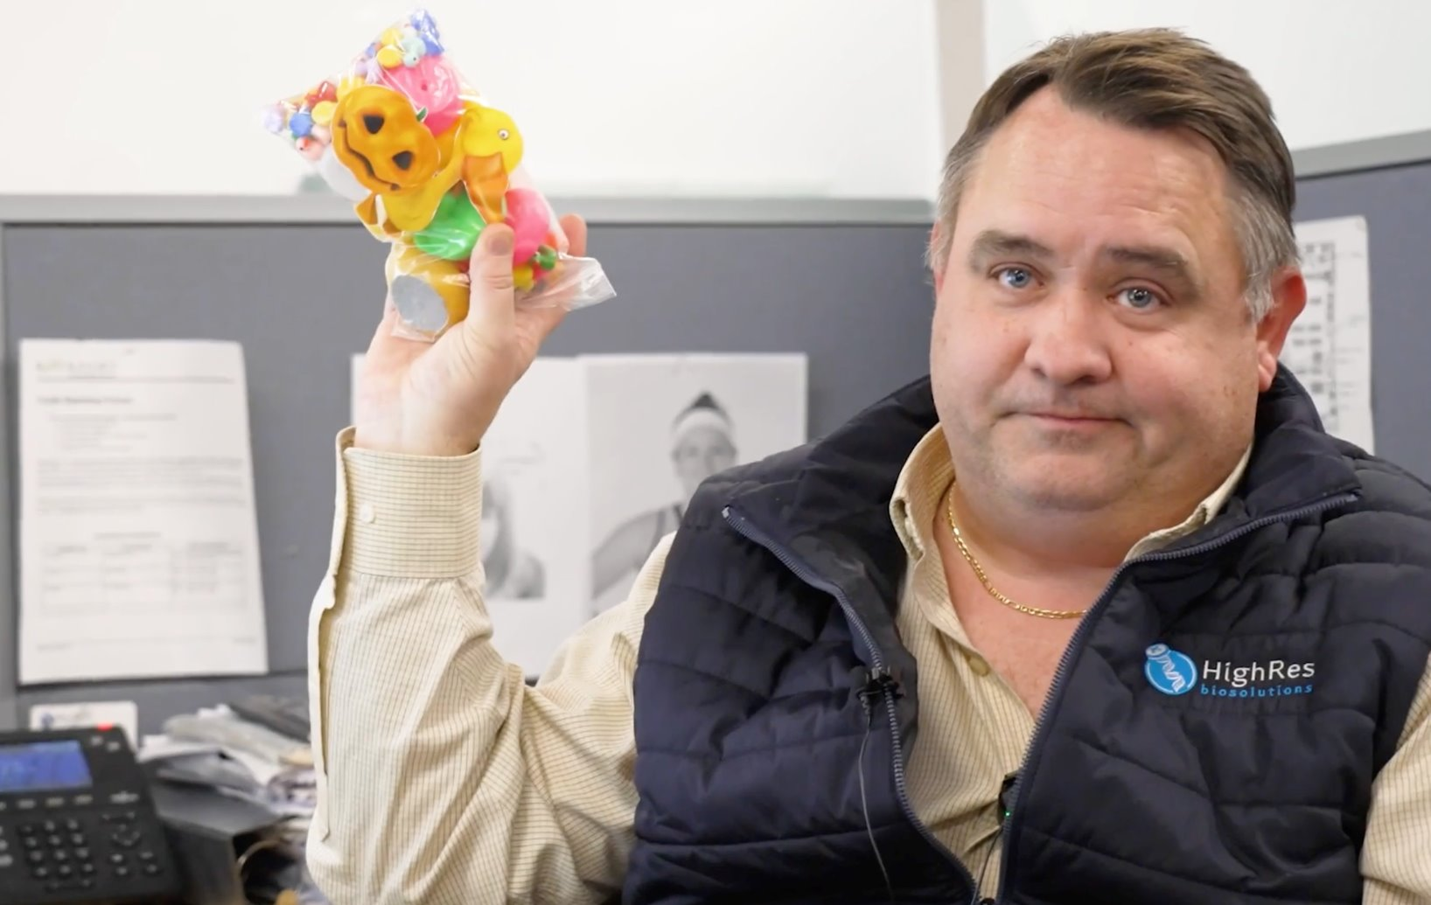
On-site Recording in Boston
HighRes® Biosolutions, a leading global laboratory automation company, was looking to launch a compelling video series to introduce their latest innovation, FlexPod. They also wanted to debut the product with an engaging sizzle at an upcoming global science and technology conference. While on-site, our team captured additional footage that was leveraged in social content throughout the year.
Our Work
Meeting with the client to lock in dates and schedules
Reviewing the scripts from the client and compiling shot lists per video
Virtual location scouting based on images provided by the client
Fly a videographer to visit their location for a day to film content for the FlexPod video series
Ensure quality is maintained while capturing as much b-roll and interview footage
With extra time, record interviews and office footage for use with social media
The Result
Delivery of a high-quality sizzle that met the client's vision and was a success at the tech conference
Delivered a video series comprising 4 videos to launch the product as well as drive customers' interest
An addition of three social videos:
  See you at SLAS clip
  Boston Favorites
  Duckster Video

